Slide 1
Guided Capstone
Presenting your work
Chana Shuster

Slide 2
Problem Identification
The problem of declining skier visits at Big Mountain Resort refers to a decrease in the number of people visiting the ski resort over time. This decline in skier visits can have negative effects on the resort's revenue and overall success. The main causes of the decline in skier visits can include a variety of factors such as reduced snowfall, lack of infrastructure investment, increased competition from other ski resorts, and changes in consumer preferences or economic conditions. Reduced snowfall and lack of infrastructure investment are particularly cited as main causes, as they can make the resort less appealing or less accessible to potential visitors.

Slide 3
Recommendation and key findings
Expanding the resort's snowmaking capacity, to ensure a reliable snow cover on the trails and attract more skiers, especially during low snowfall seasons.
Investing in new ski trails, to offer more variety and attract more experienced skiers.
Providing more off-mountain activities, such as snow tubing, ice skating, and zip-line course, to extend the average stay of visitors and attract a larger audience.

Slide 4
Recommendation and key findings
These recommendations have the potential to increase skier visits by 5-10% as well as increase revenue through ticket price increases. Additionally, providing off-mountain activities can also increase revenue through additional sales such as food, rental and other activities. It's important to note that these recommendations should be implemented in a phased and strategic manner to ensure that the resort can continue to provide a top-notch visitor experience while also generating revenue.

Slide 5
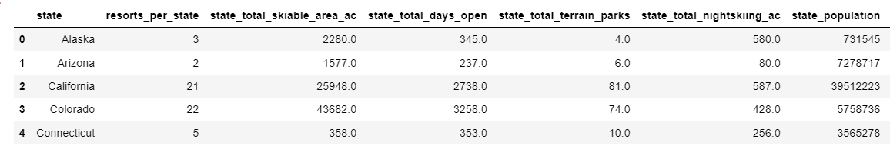
Modeling results and analysis
This is a data frame of summary statistics for various states. Only the first 5 states are shown in the above table.

Slide 6
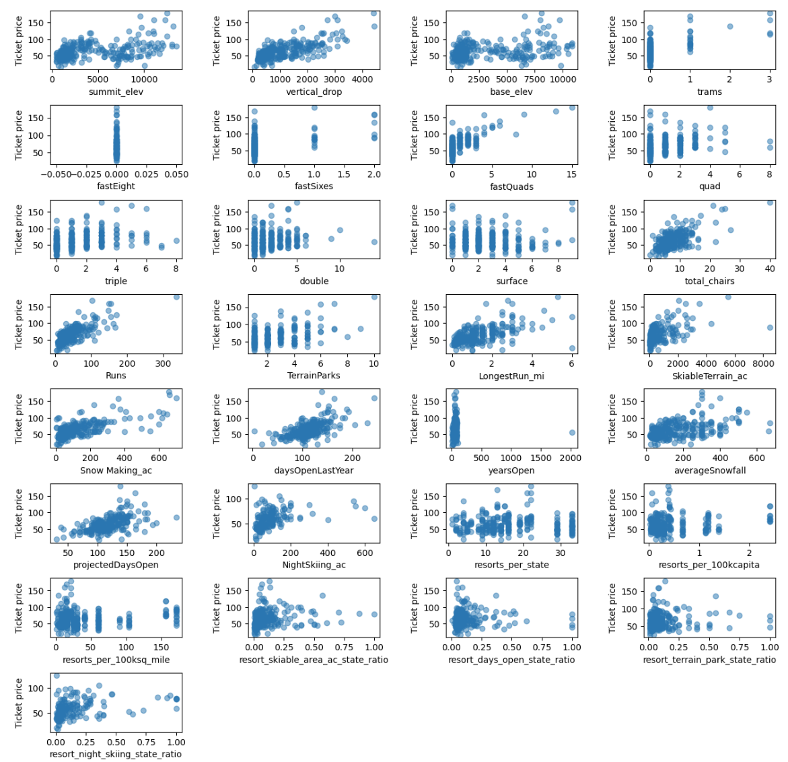
Modeling results and analysis
The scatterplots show that there is a strong positive correlation with vertical_drop, fastQuads is useful, Runs and total_chairs are quite similar and also useful. The resorts_per_100kcapita shows interesting information, when the value is low, there is quite a variability in ticket price, indicating that ticket price may drop a little before then climbing upwards as the number of resorts per capita increases. It may suggest that ticket price could climb with the number of resorts serving a population because it indicates a popular area for skiing with plenty of demand. The lower ticket price when fewer resorts serve a population may similarly be because it's a less popular state for skiing. The high price for some resorts when resorts are rare (relative to the population size) may indicate areas where a small number of resorts can benefit from a monopoly effect.

Slide 7
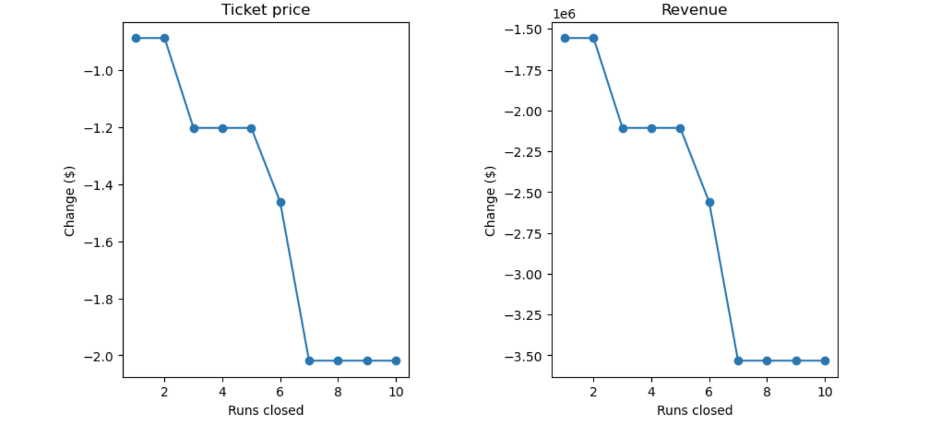
Modeling results and analysis
According to the model, ending one run has little impact. Closing doors 2 and 3 in succession lowers support for ticket prices and consequently revenue. Big Mountain might as well stop running runs 4 or 5 if they stop 3 as there won't be any future price increases. A significant decline occurs when the number of closures is raised to 6 or more.

Slide 8
Summary and Conclusion
The problem of declining skier visits at Big Mountain Resort has been identified and it has been observed that it has been decreasing by 4% annually for the past 4 years. The main causes of decline are reduced snowfall and lack of infrastructure investment. Recommendations to increase skier visits and revenue have been provided which include expanding snowmaking capacity, investing in new ski trails and providing off-mountain activities. These recommendations have the potential to increase skier visits by 5-10% and revenue through ticket price increases. Implementation of these recommendations should be strategic and phased while maintaining a top-notch visitor experience.

Slide 9
Summary and Conclusion
The recommendations for increasing skier visits and revenue at the resort are:
Improve snowmaking capacity to ensure a reliable snow cover on the trails.
Invest in new ski trails to offer more variety and attract more experienced skiers.
Provide more off-mountain activities such as snow tubing, ice skating, and zip-line course, to extend the average stay of visitors and attract a larger audience.
The next steps for management of the resort to implement the recommendations would be to:
Prioritize which trails to work on while also making efforts to use less water and electricity to expand snowmaking capacity.
Conduct more research and give themselves plenty of time to adequately plan, create, and carry out the modifications for the off-mountain activities.
Gradually raise ticket prices while ensuring the resort continues to provide a top-notch experience.
Continuously monitor the progress and adapt the strategy as needed.

